Slide 1
Facial Expression Detection
2022 Spring DSE I2100
Applied Machine Learning and Data Mining
Professor: Michael Grossberg
By Chikako Olsen, Ivan Miller, Rabiul Hossain

Slide 2
Goals
Detect human emotion from face expression
Find out which feature transformation works the best
Find out which ML model gives the best accuracy
Compare results achieved by classical ML methods with NN
Look into activation of neurons in different layers of the NN
Notes:
Compare results achieved by classical machine learning methods with neural networks
Look into activation of neurons in different layers of the neural network

Slide 3
Dataset

Slide 4
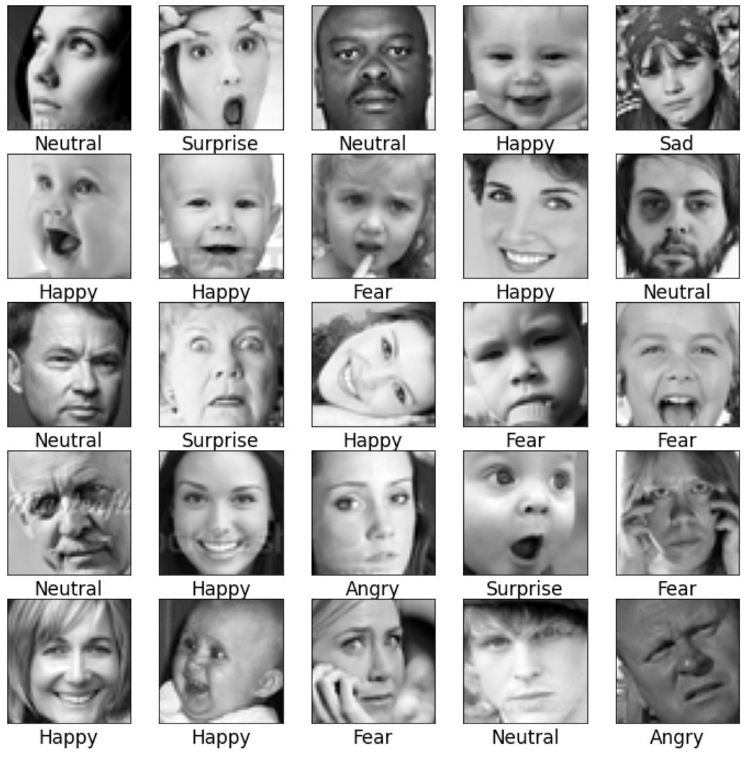
The Data
Kaggle
48x48 grayscale images of faces
36k images
7 classes of emotions

Slide 5
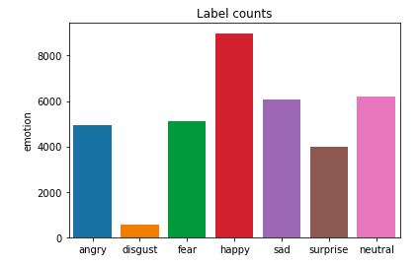
EDA

Slide 6
Classic Machine Learning

Slide 7
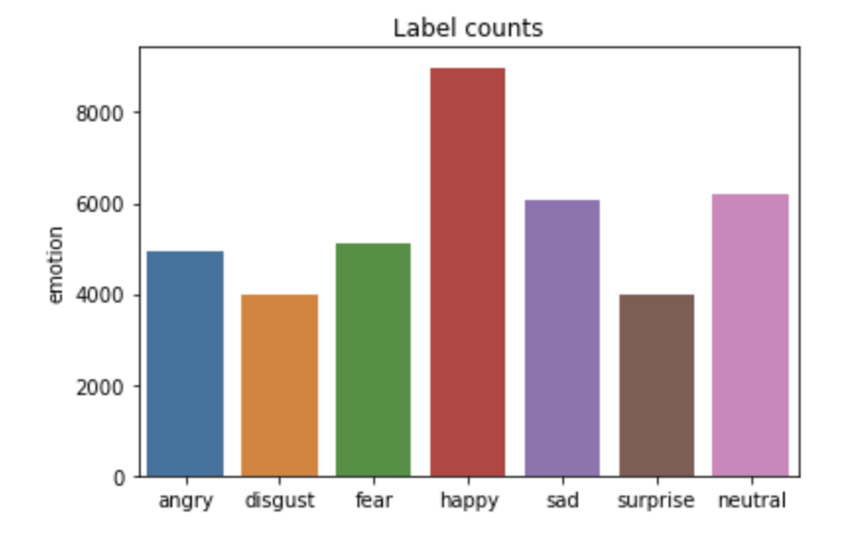
Clean and Balanced Data
Deleted Black / White only images
Made disgust same amount as surprise label

Slide 8
Feature Transformation
EigenFace
FisherFace
Bag of Features
HoG
Affine transformation
Technique we used

Slide 9
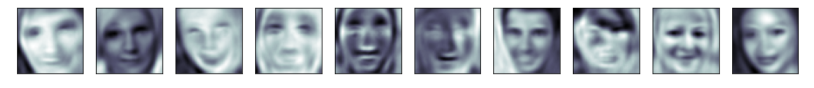
EigenFace (PCA) n_component = 103 (90%)
PCA Inverse

Slide 10
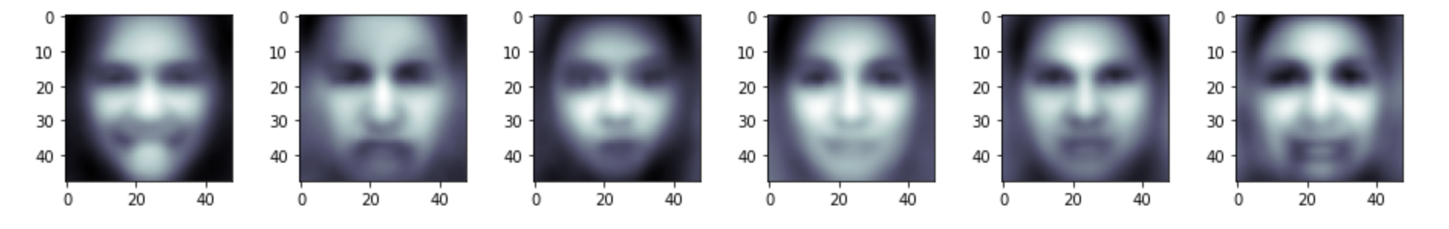
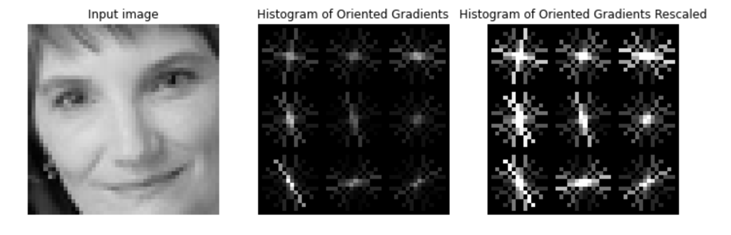
FisherFace (PCA + LDA)
HoG (Histogram of oriented gradients)

Slide 11
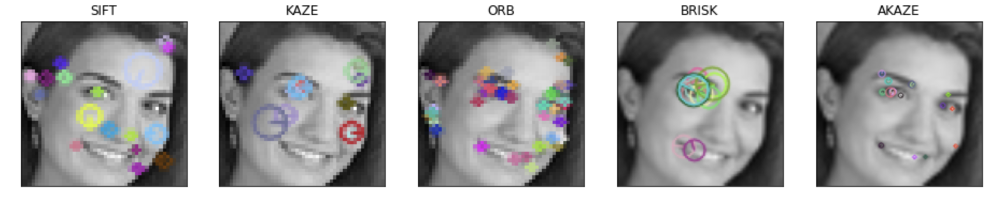
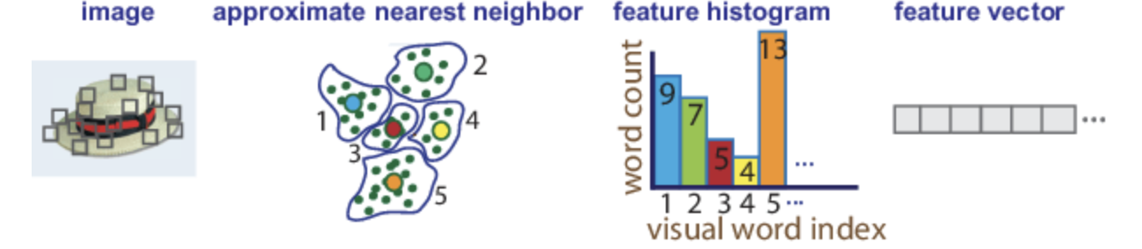
Bag of Features (Bag of Visual Words)
Extract feature descriptors.
2. Apply the k-means clustering to the extracted feature descriptors to define the features (visual words).
3. Use the bag of visual words to encode an image in an image set into a histogram of visual words.

Slide 12
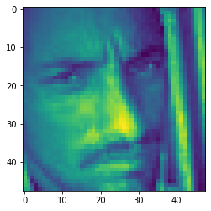
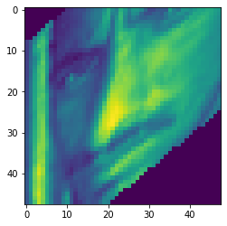
Affine transformation
Original Image
Transformed Image

Slide 13
Machine Learning
SVM
KNN
SGD
Random Forest
Algorithms we used

Slide 14
Hyper parameters for comparison
SVM parameters:
kernel = ‘rbf’, gamma = ‘auto’, C = 5, decision_function_shape=’ovo’
KNN parameters:
n_neighbors = 3, weights = ‘distance’, metric = ‘minkowski’

Slide 15
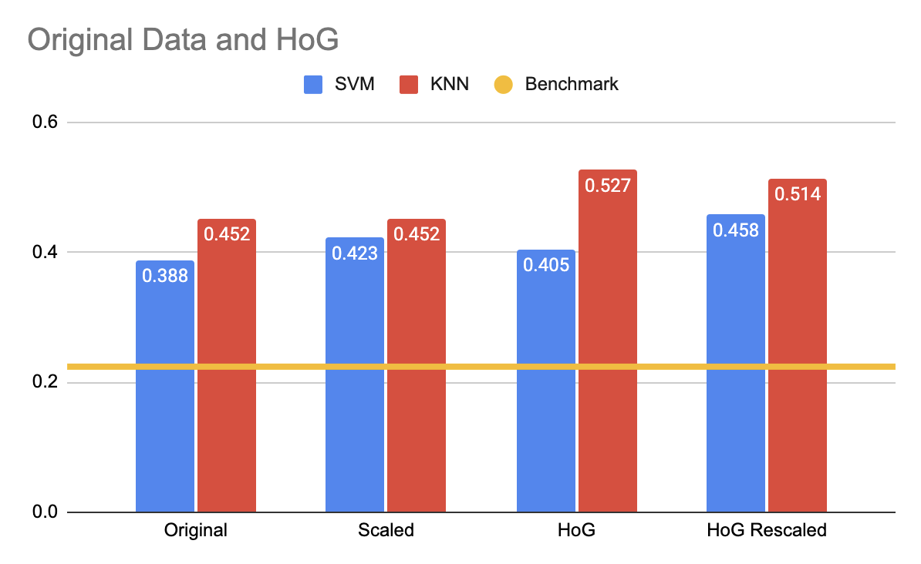

Slide 16
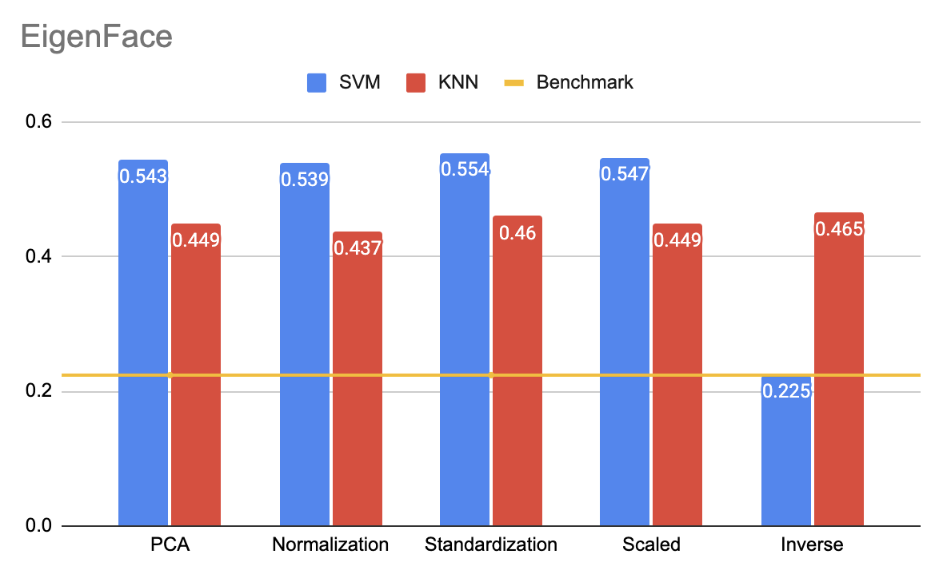

Slide 17
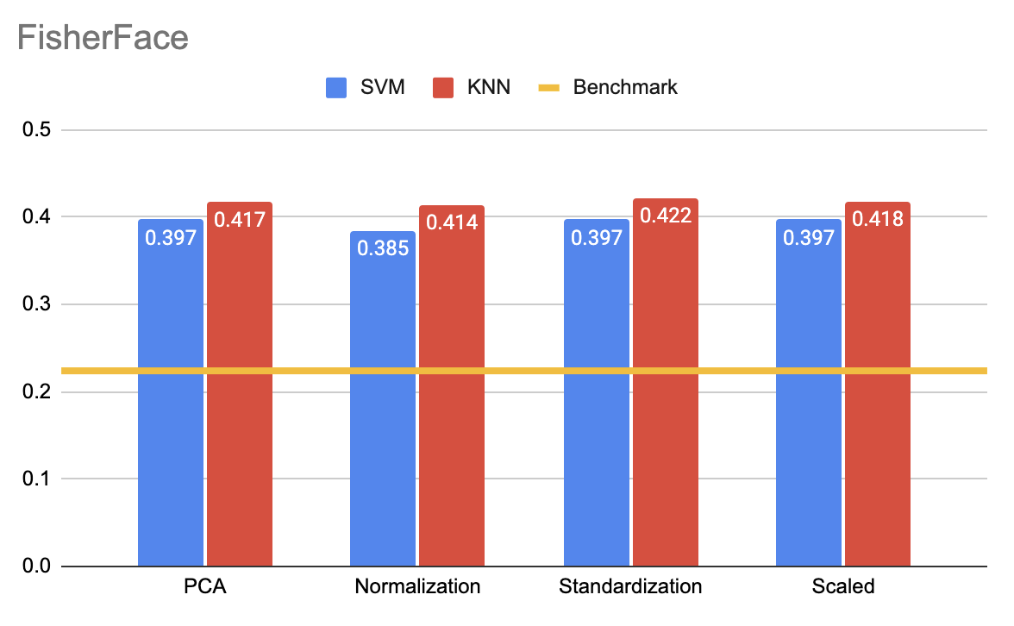

Slide 18
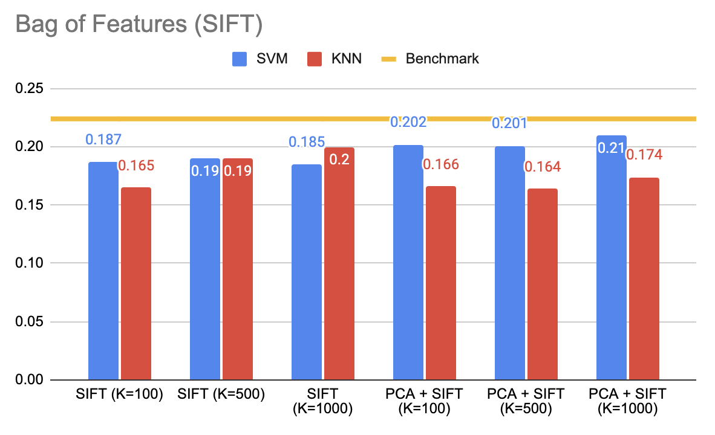

Slide 19
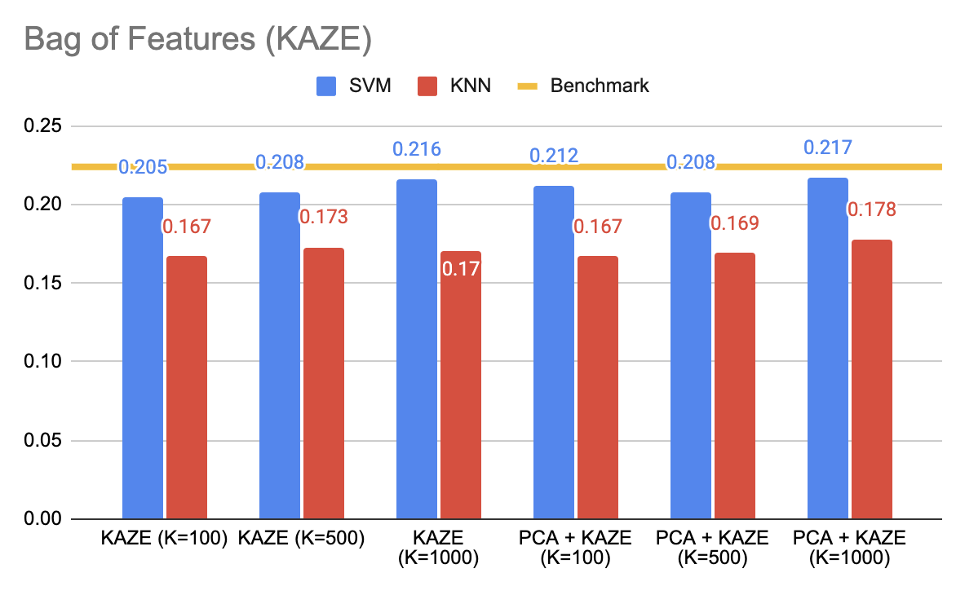

Slide 20
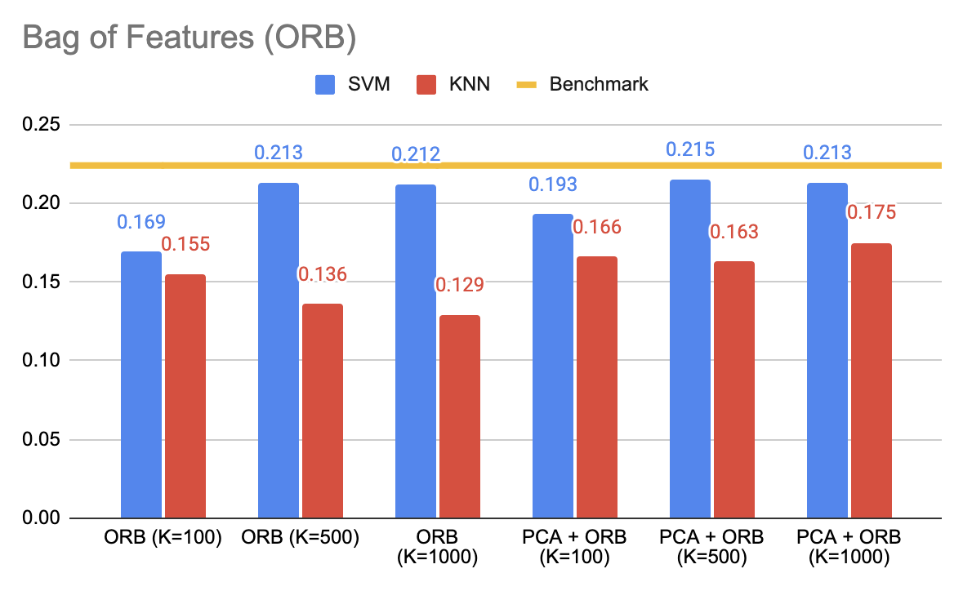

Slide 21
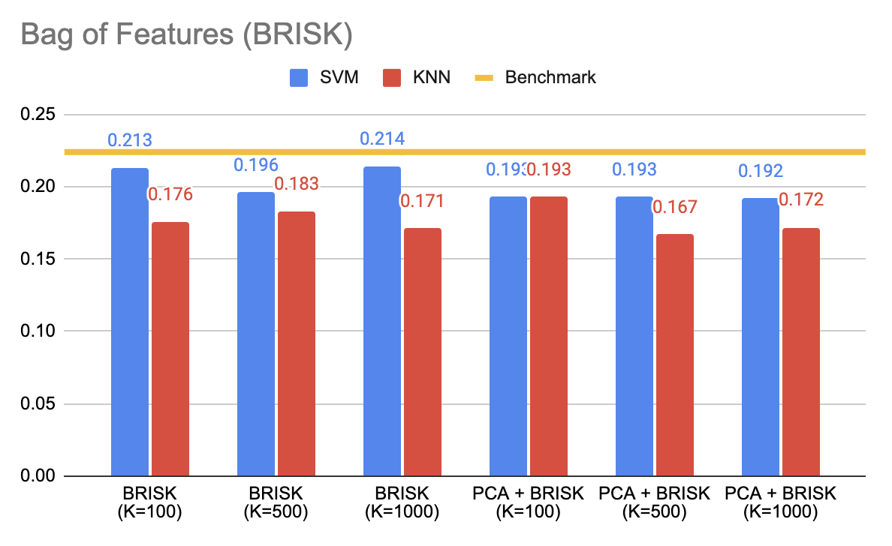

Slide 22
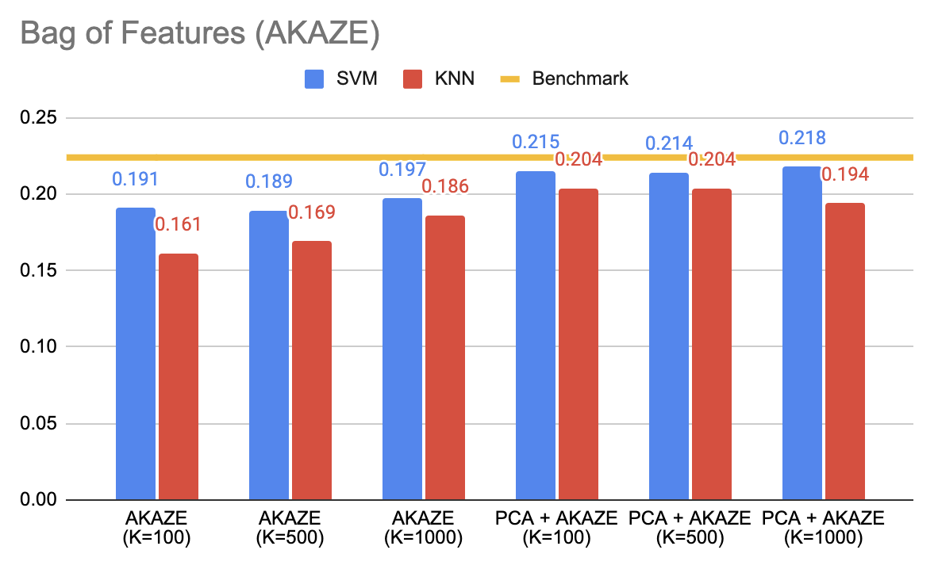

Slide 23
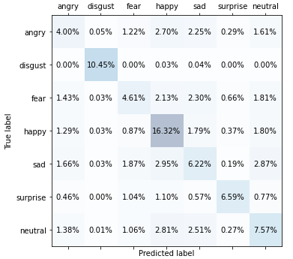
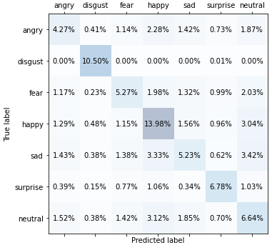
Confusion Matrix
SVM (PCA Standardization)
KNN (HoG)

Slide 24
Performance Metrics
SVM (PCA Standardization)
Precision: 0.577
Recall: 0.559
F1: 0.564
Accuracy: 0.558
KNN (HoG)
Precision: 0.532
Recall: 0.540
F1: 0.532
Accuracy: 0.527

Slide 25
Classification Report
SVM (PCA Standardization)
precision recall f1-score support
angry 0.39 0.33 0.36 957
disgust 0.99 0.99 0.99 830
fear 0.43 0.36 0.39 1024
happy 0.58 0.73 0.65 1774
sad 0.40 0.39 0.40 1247
surprise 0.79 0.63 0.70 831
neutral 0.46 0.48 0.47 1233
KNN (HoG)
precision recall f1-score support
angry 0.42 0.35 0.38 957
disgust 0.84 1.00 0.91 830
fear 0.47 0.41 0.44 1024
happy 0.54 0.62 0.58 1774
sad 0.45 0.33 0.38 1247
surprise 0.63 0.64 0.64 831
neutral 0.37 0.42 0.39 1233

Slide 26
Classification Report (continue)
SVM (PCA Standardization)
precision recall f1-score support
accuracy 0.56 7896
macro avg 0.58 0.56 0.56 7896
weighted avg 0.56 0.56 0.55 7896
KNN (HoG)
precision recall f1-score support
accuracy 0.53 7896
macro avg 0.53 0.54 0.53 7896
weighted avg 0.52 0.53 0.52 7896

Slide 27
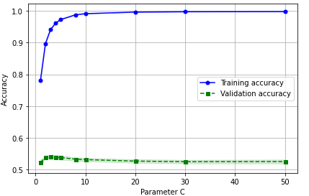
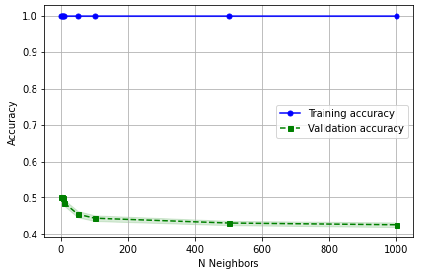
Validation curve
SVM
KNN

Slide 28
SGD
SGD Parameters
Alpha: 0.1
Penalty: L2
max_iter: 5000
Loss: log
Results
Original dataset
Accuracy: 27.1%
Affine transformation/Augmentation
Accuracy: 15.55%
HoG Rescaled
Accuracy: 45.29%

Slide 29
RandomForest
RandomForest Parameters
criterion: entropy
max_depth: 8
max_features: auto
n_estimators: 200
Results
Original dataset
Accuracy: 44.9%
Affine transformation/Augmentation
Accuracy: 17.21%
HoG Rescaled
Accuracy: 48.19%

Slide 30
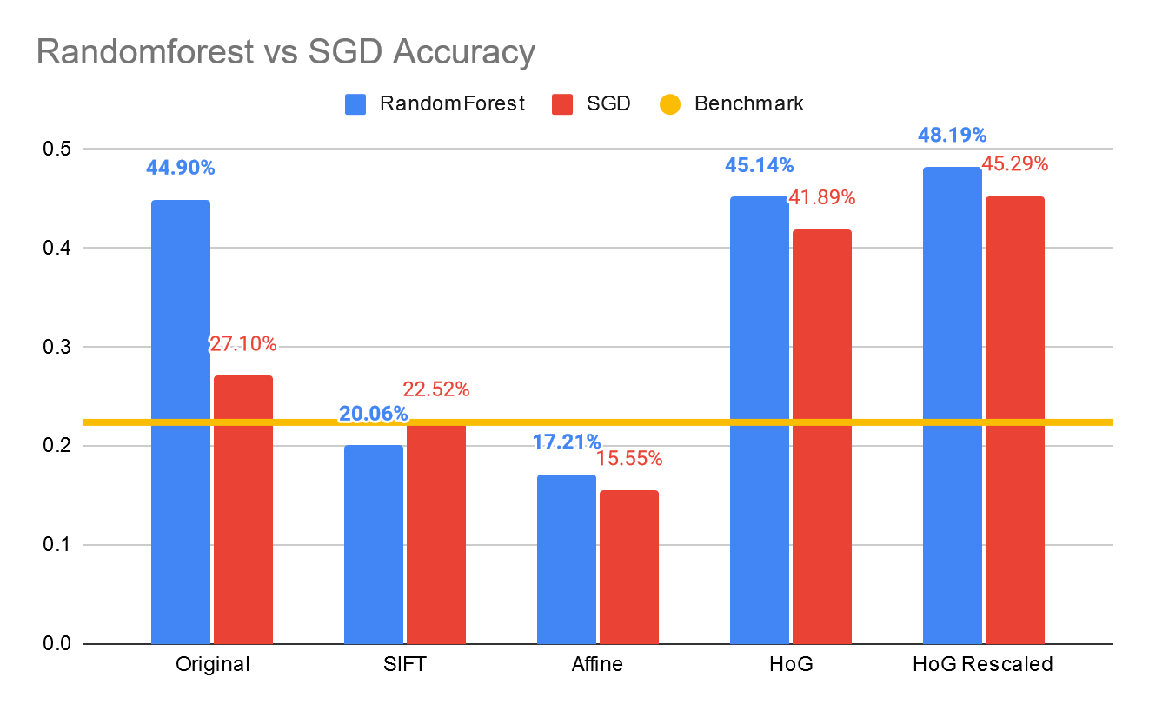

Slide 31
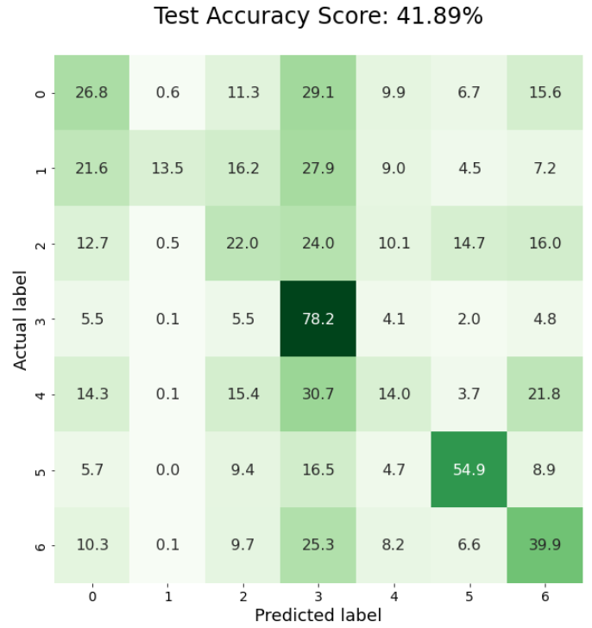
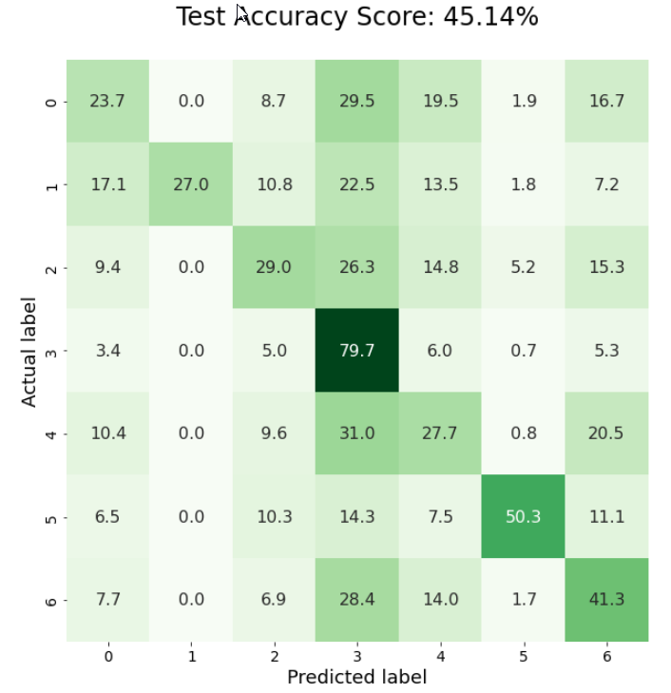
Confusion Matrix
SDG(HoG)
Randomforest (HoG)

Slide 32
Overall
The best accuracy among BoF are below than benchmark.
EigenFace and HoG were the best result.
Alghouth highest accuracy 55.4% may seem not high, it is good result compare to benchmark.

Slide 33
Neural Network

Slide 34
RMSProp (Root Mean Squared Propagation)
Solves vanishing gradients problem
Use a moving average of squared gradients to normalize them
Divide the gradient by the root of this average
Adaptive learning rate
Notes:
vanishing gradients problem - gradients of NNs with many layers tend to either explode or vanish
by decreasing the step for large gradients to avoid exploding and increasing the step for small gradients to avoid vanishing
Simply put, RMSprop uses an adaptive learning rate instead of treating the learning rate as a hyperparameter. This means that the learning rate changes over time.

Slide 35
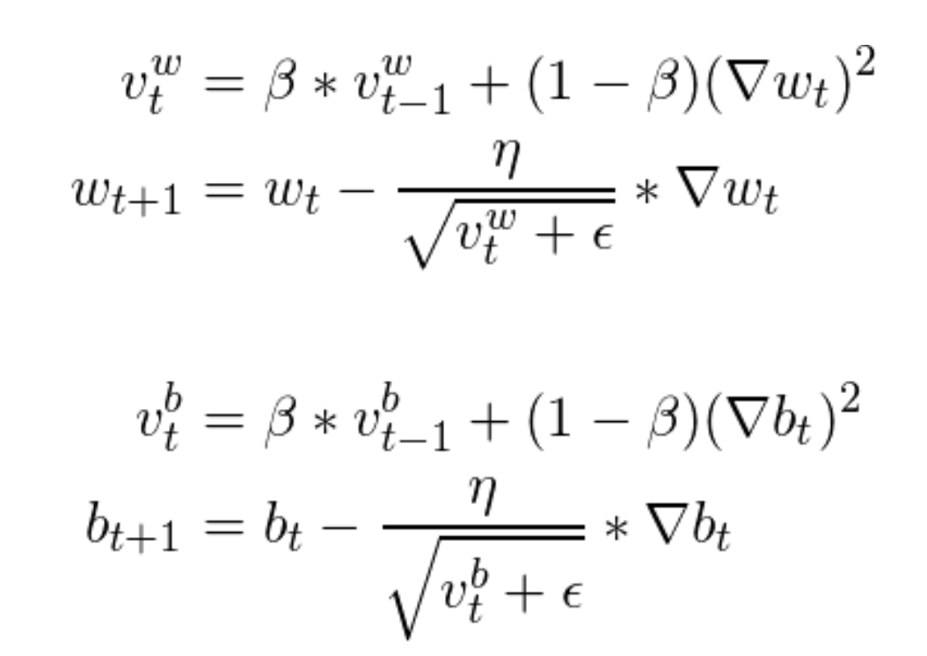
RMSProp Update Rule
Notes:
vanishing gradients problem - gradients of NNs with many layers tend to either explode or vanish
by decreasing the step for large gradients to avoid exploding and increasing the step for small gradients to avoid vanishing
Simply put, RMSprop uses an adaptive learning rate instead of treating the learning rate as a hyperparameter. This means that the learning rate changes over time.

Slide 36
Loss Function
Sparse Categorical Cross Entropy
Notes:
Classes were not one hot encoded -

Slide 37

CNN with
4 Sets of Convolutional and Pooling layers
Convolutional:
3x3 kernel size
RELU Activation
Pooling:
2x2
50% Dropout layer
2 Dense layers:
512 Units, RELU
256 Units, RELU
Dense: 7 Units, Softmax
800 epochs
Notes:
2x2 pooling layers (reducing the number of parameters)
50% dropout layers (regularization)

Slide 38
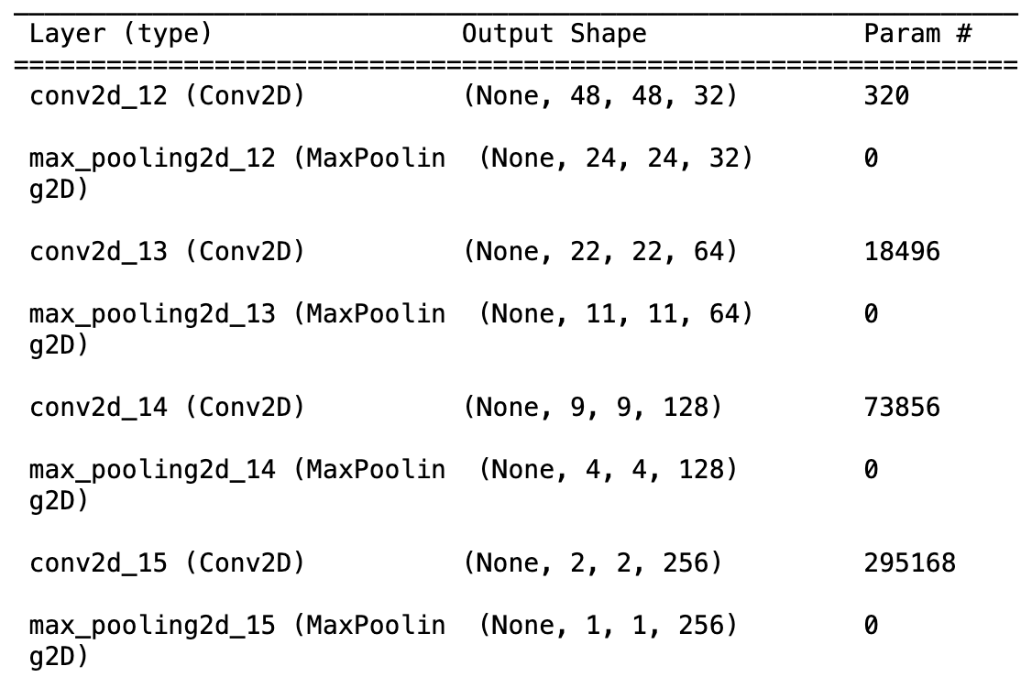
Model Summary

Slide 39
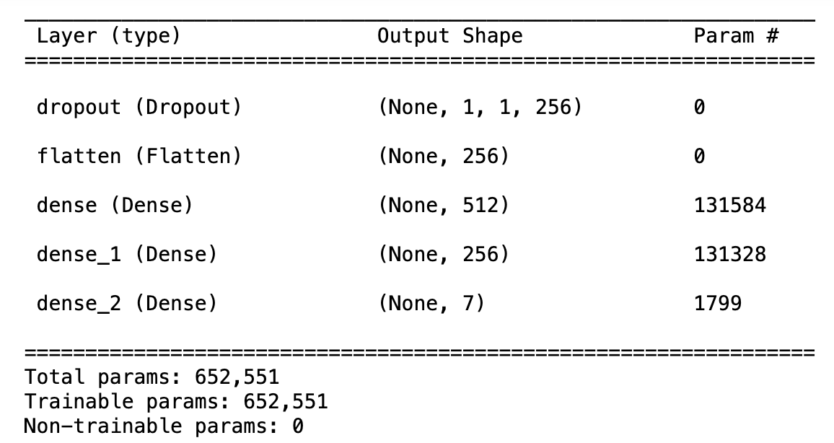
Model Summary

Slide 40
Image Augmentation in batches ~ 7s per epoch
40 degree random rotation
20% width/height shift
Up to 20% zoom
Up to 20% shear (stretch)
Random horizontal flip

Slide 41
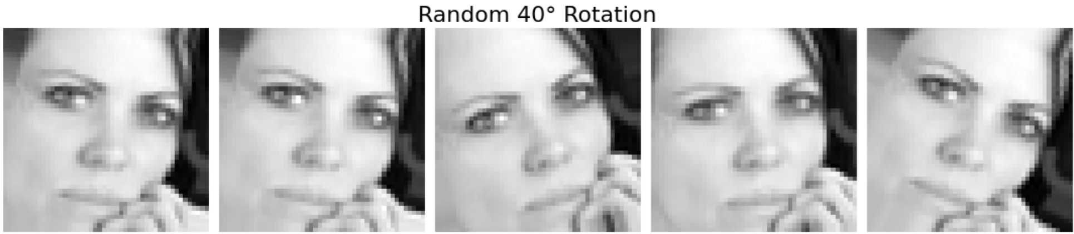
Image Augmentation: Rotation

Slide 42
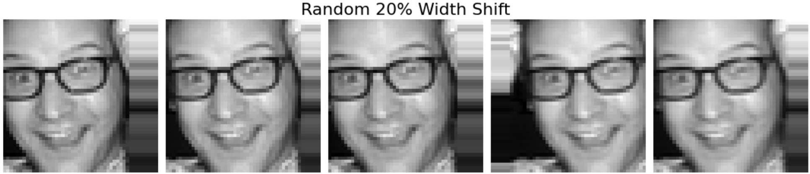
Image Augmentation: Width Shift

Slide 43
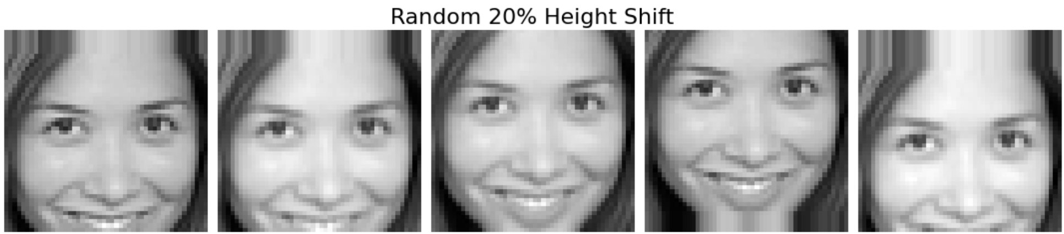
Image Augmentation: Height Shift

Slide 44
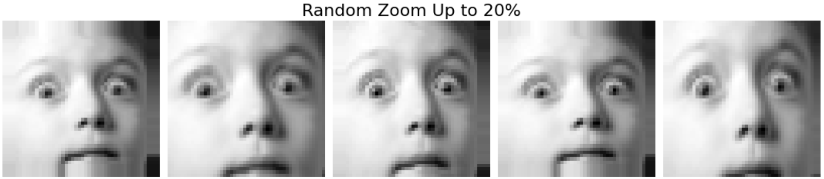
Image Augmentation: Zoom

Slide 45
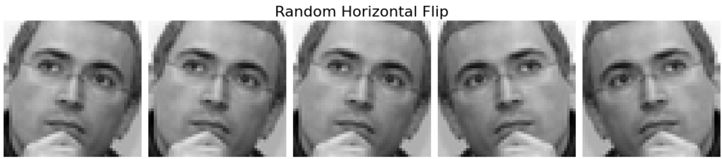
Image Augmentation: Horizontal Flip

Slide 46
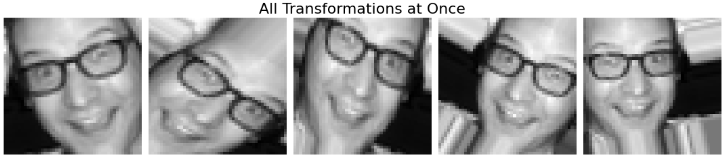
Image Augmentation: All Transformations

Slide 47
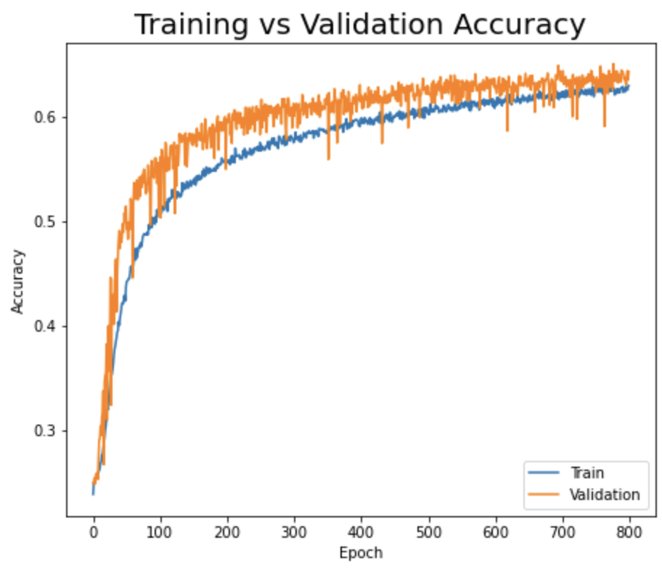

Slide 48
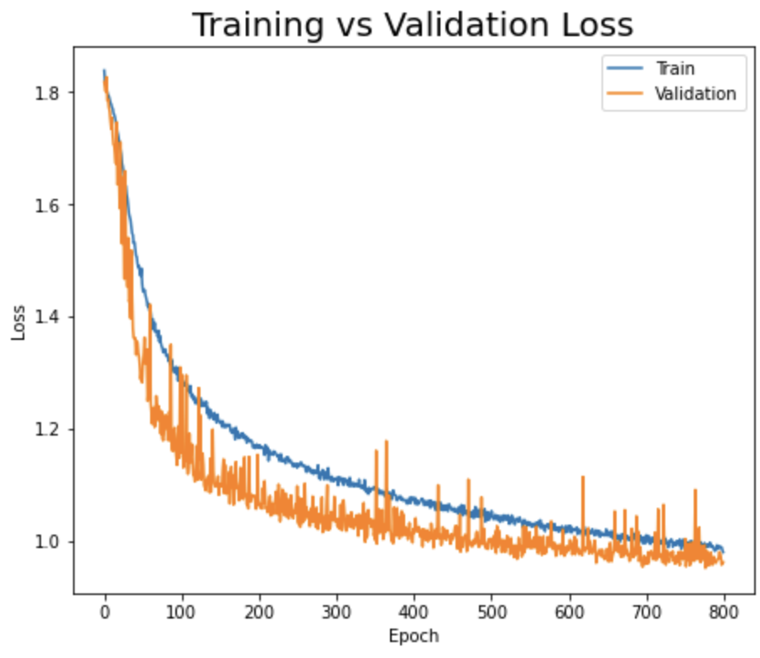

Slide 49
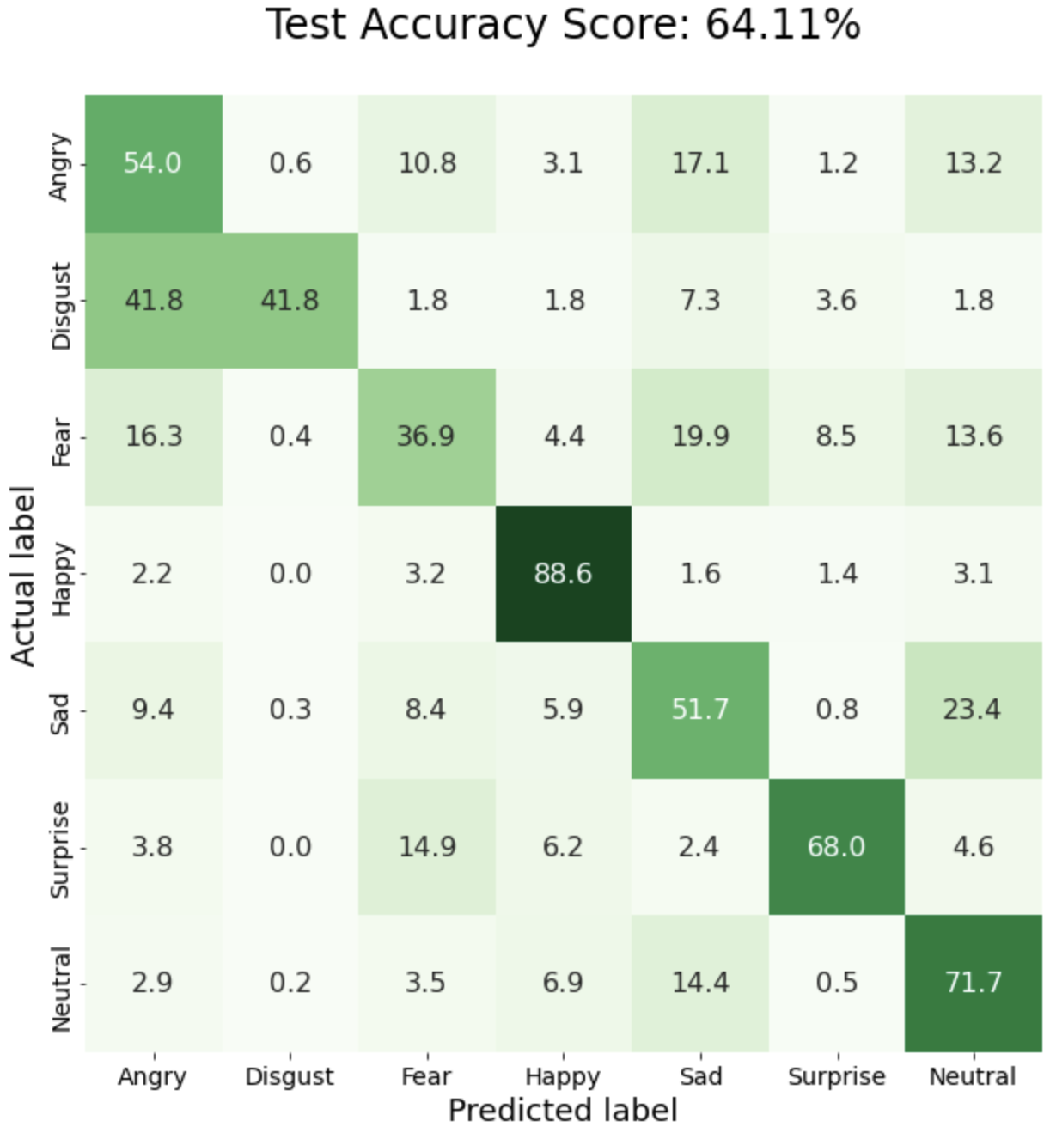
Diagonal elements represent the percent of labels for which the class predicted by the model was correct.

Slide 50
Top 5 models from Kaggle competition have accuracy between 65 and 71%

Slide 51
Learnings about Neural Networks:
Data!!!
Model design matters!
Learn in batches

Slide 52
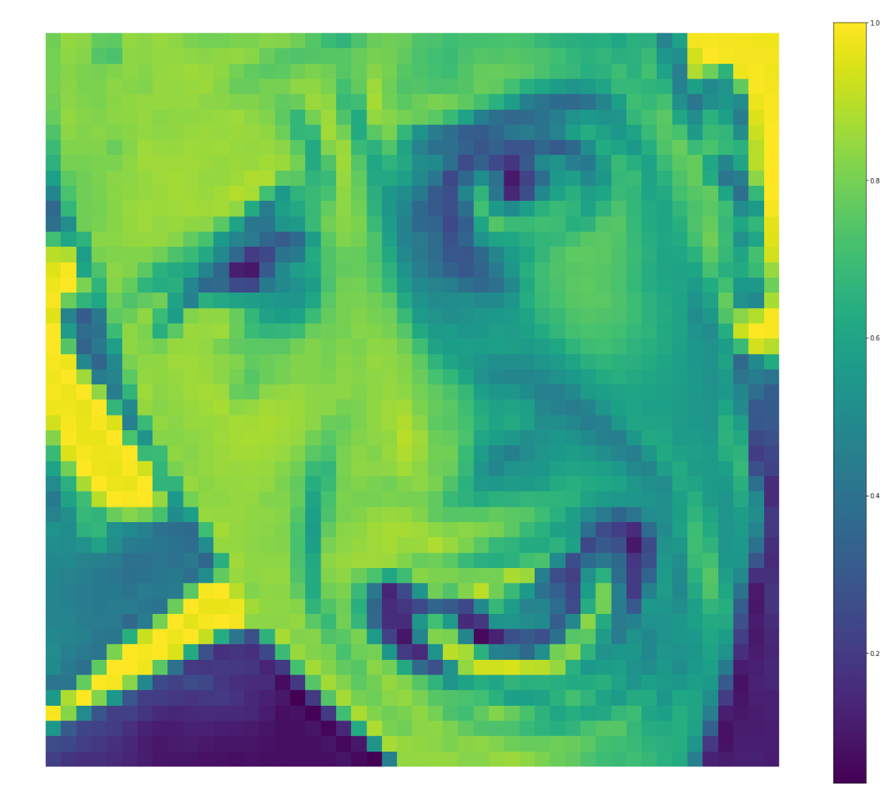
Activation Maps - Original Image - Fear

Slide 53
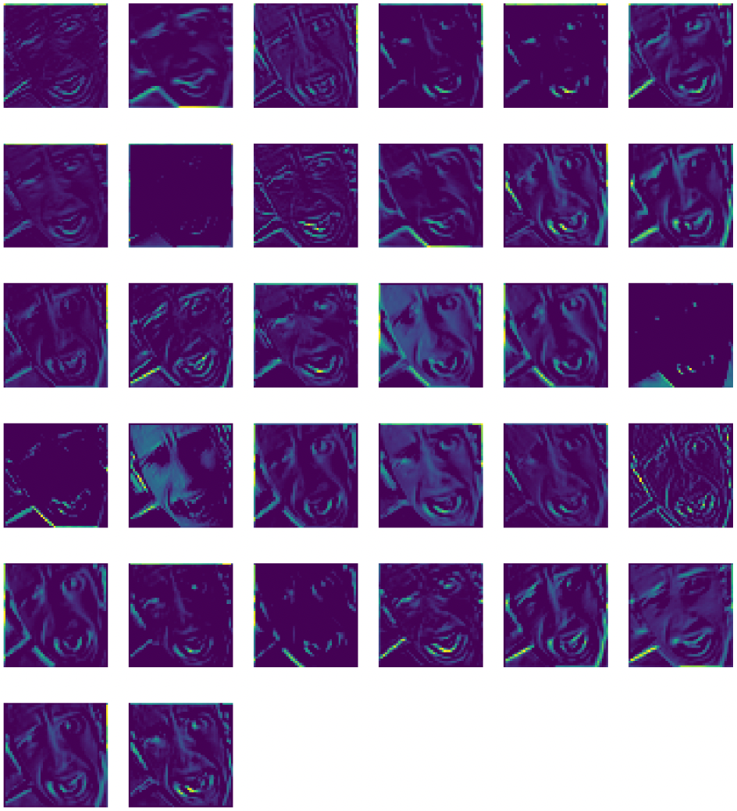
1st Convolutional Layer
(48 x 48)

Slide 54
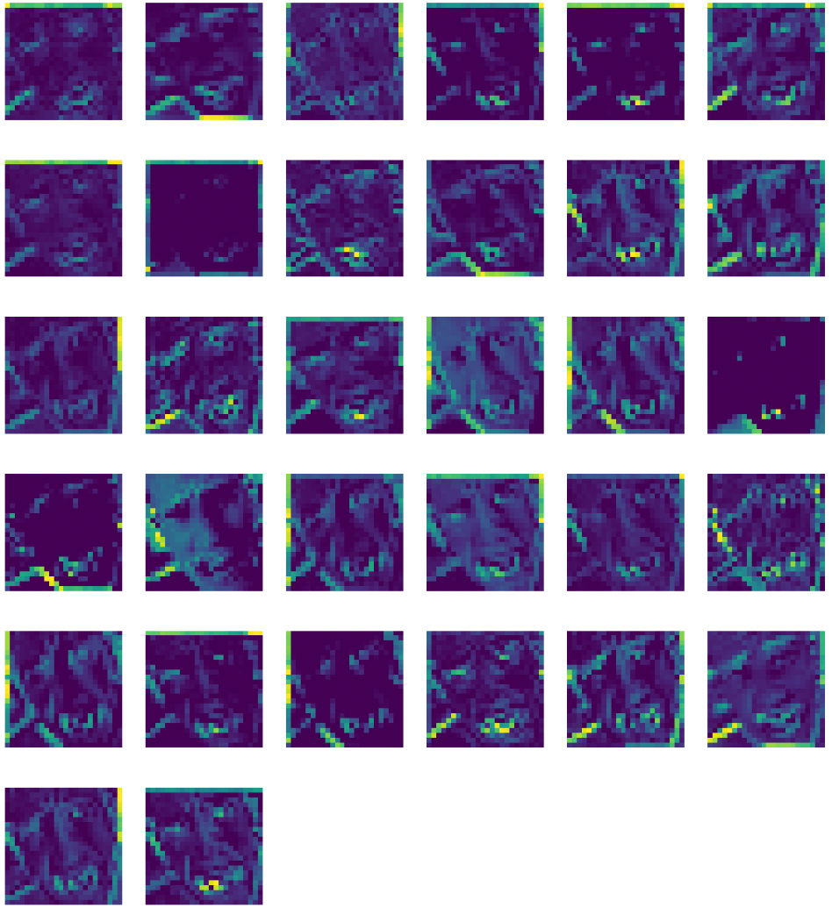
1st Pooling Layer
(24 x 24)

Slide 55
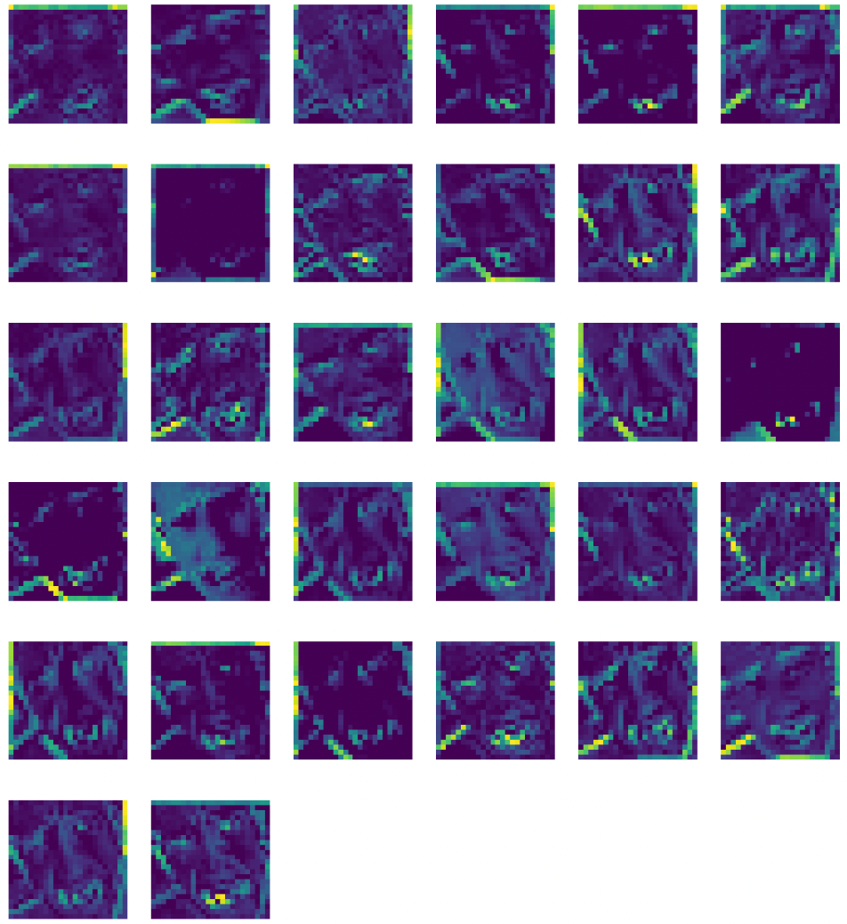
2nd Convolutional Layer (22 x 22)

Slide 56
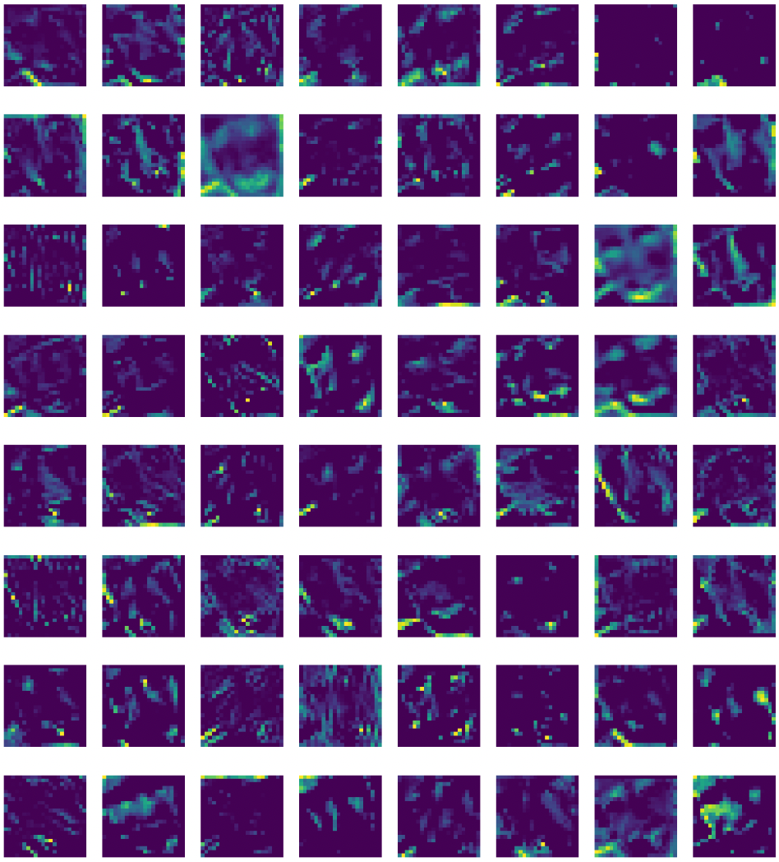
2nd Pooling Layer
(11 x 11)

Slide 57
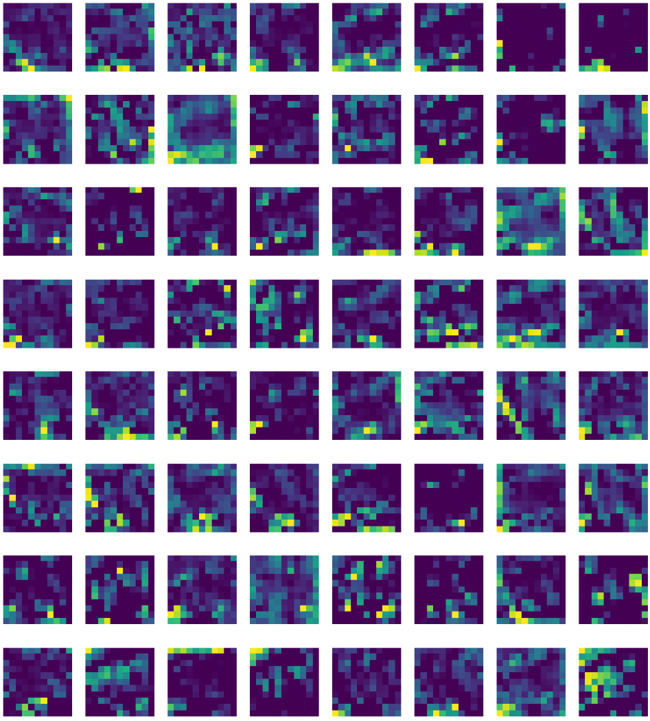
3rd Convolutional Layer (9 x 9)

Slide 58
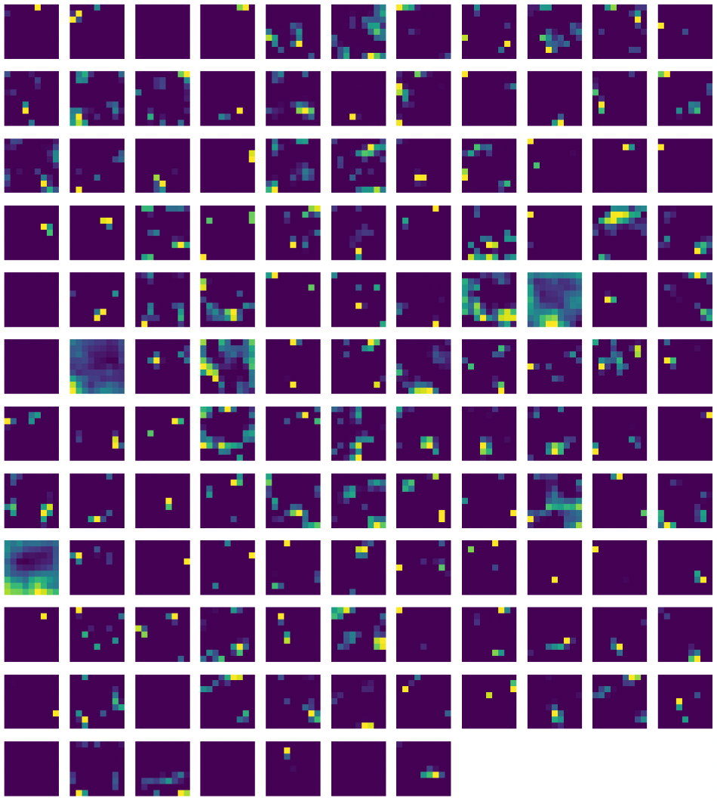
3rd Pooling Layer
(4 x 4)

Slide 59
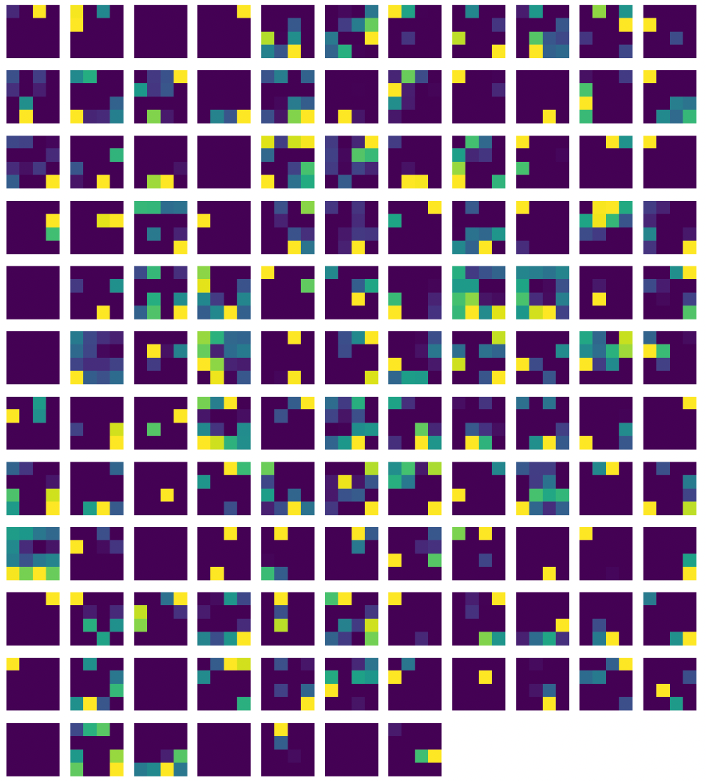
4th Convolutional Layer (2 x 2)

Slide 60
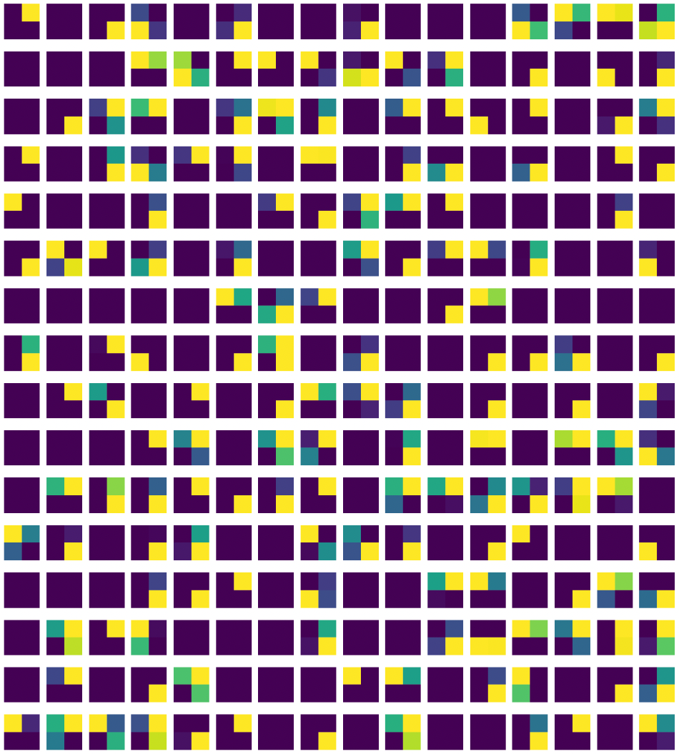
4th Pooling Layer
(1 x 1)

Slide 61
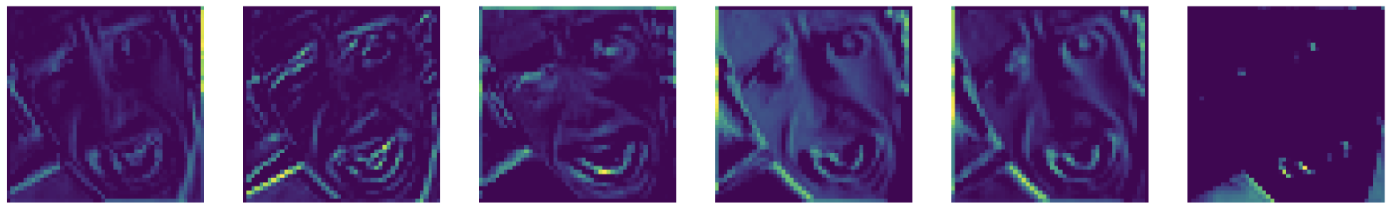
1st Convolutional Layer (48 x 48) - zoom

Slide 62
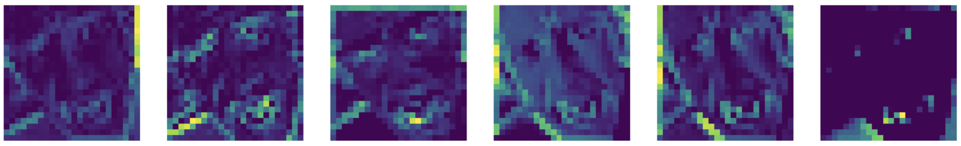
1st Pooling Layer (24 x 24) - zoom

Slide 63
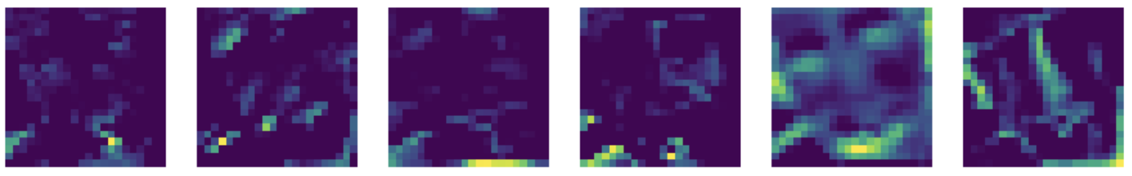
2nd Convolutional Layer (22 x 22) - zoom

Slide 64
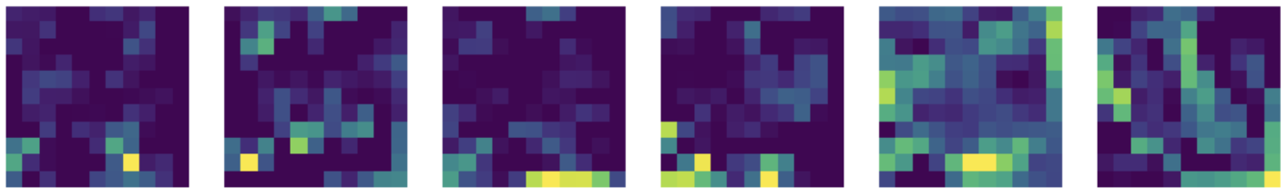
2nd Pooling Layer (11 x 11)

Slide 65
Demonstration

Slide 66
Contribution

Slide 67


Slide 68
Thank you

